Slide 1

National Career Readiness Certificate ™

Slide 2
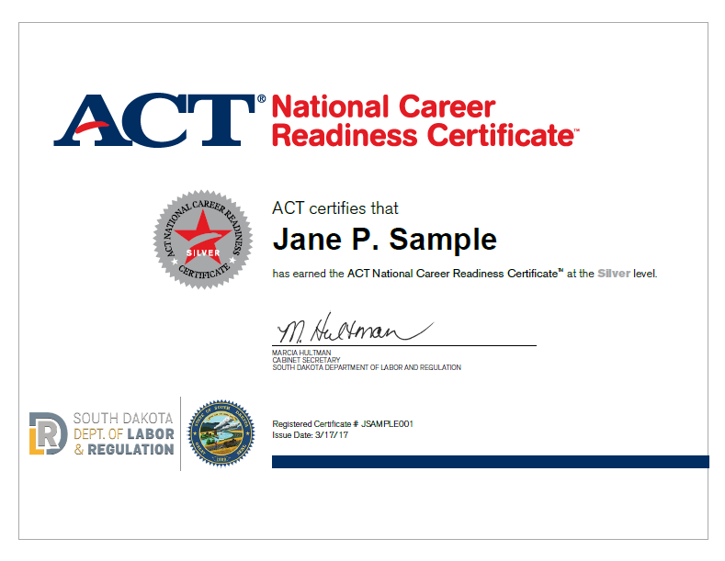
National Career Readiness Certificate
(NCRC)

Slide 3



National Career Readiness Certificate

Slide 4



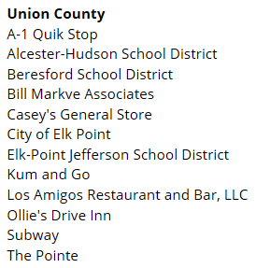




National Career Readiness Certificate

Slide 5

National Career Readiness Certificate
Applied math
Graphic literacy
Workplace documents

Slide 6

National Career Readiness Certificate
What are the assessments like?

Slide 7

National Career Readiness Certificate
Applied Math

Slide 8
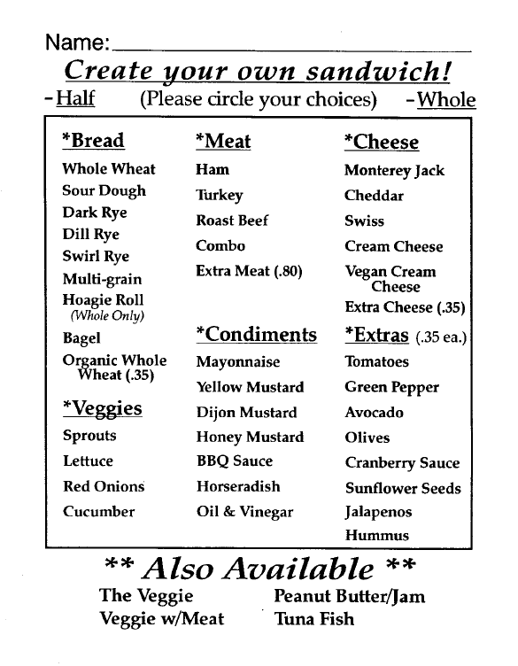
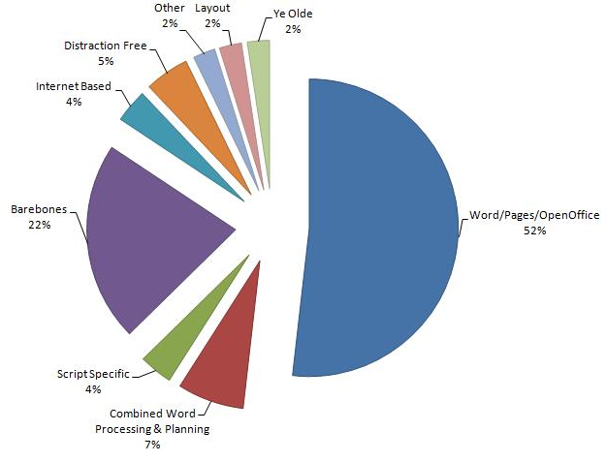
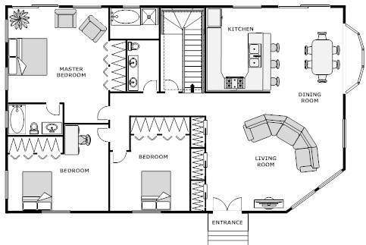
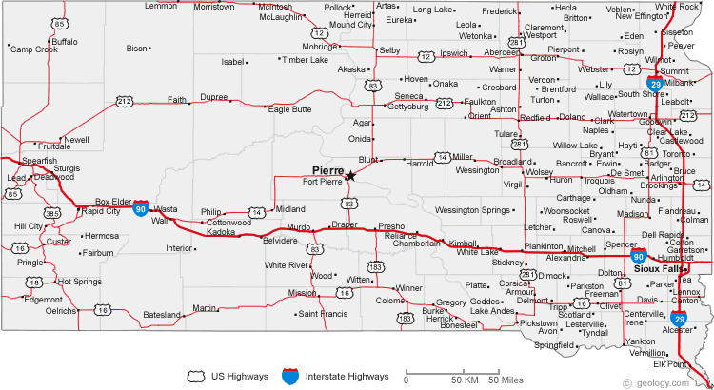
National Career Readiness Certificate
Graphic Literacy

Slide 9
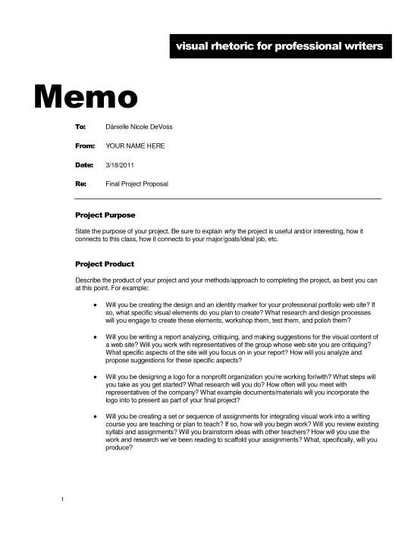


National Career Readiness Certificate
Workplace Documents

Slide 10

National Career Readiness Certificate

Slide 11
National Career Readiness Certificate
 | Applied Math | Workplace Documents | Graphic Literacy
Bronze | 3 | 3 | 3
Silver | 4 | 4 | 4
Gold | 5 | 5 | 5
Platinum | 6-7 | 6-7 | 6-7

Slide 12

National Career Readiness Certificate

Slide 13
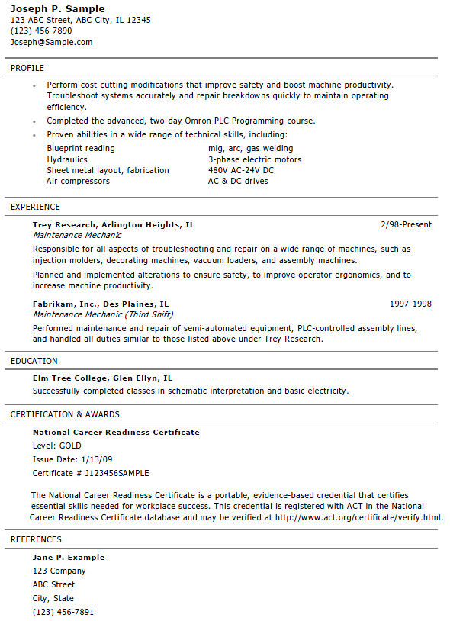
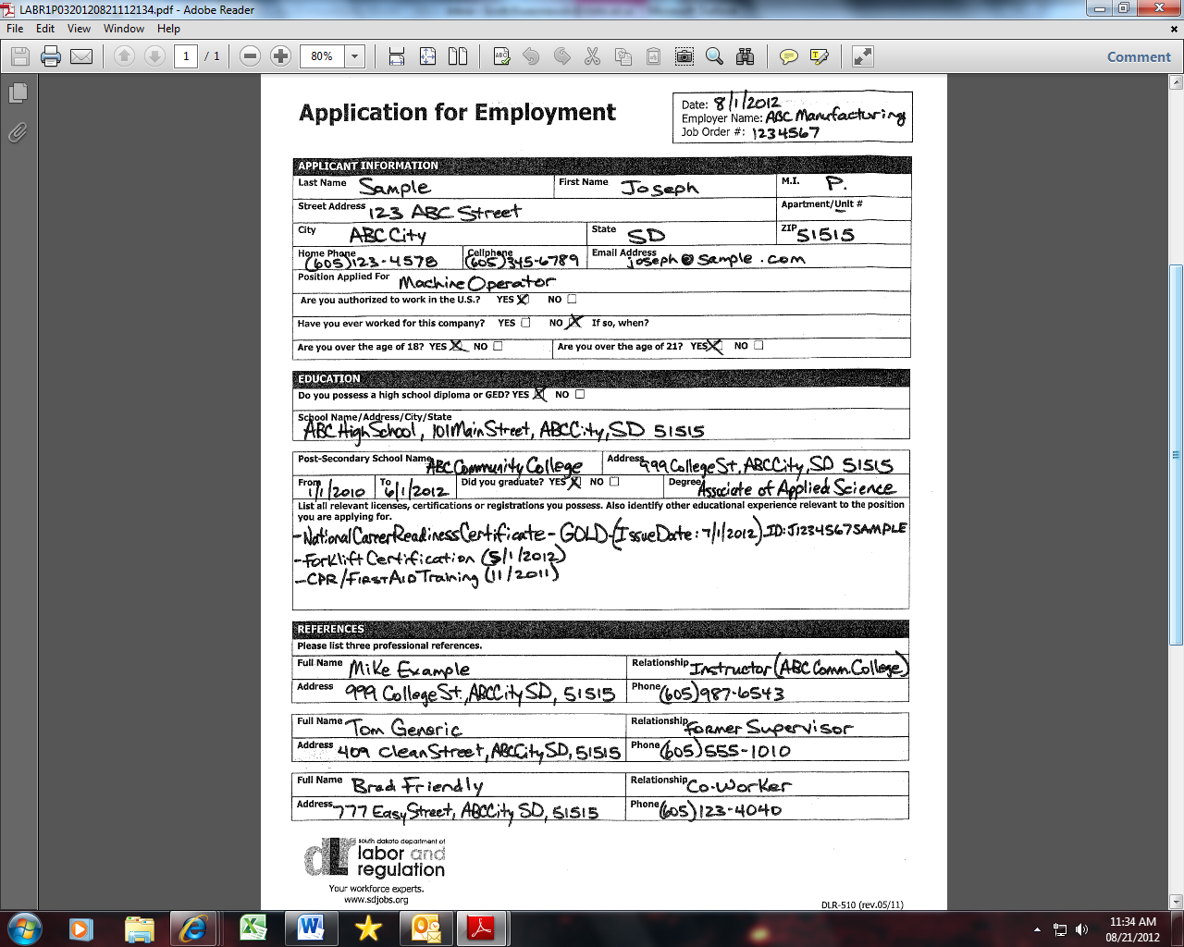
National Career Readiness Certificate

Slide 14


National Career Readiness Certificate

