Slide 1
Workforce Training Youth Program
Notes:
Every year South Dakota Department of Labor and Regulation receives funding from the US Department of Labor through the Workforce Innovation and Opportunities Act to assist young adults ages 16 through 24 develop their skills to become self-sufficient adults.

Slide 2
Notes:
The Workforce Training program will help you explore careers, identify an employment goal, develop skills and complete a job search while receiving necessary supports along the way.

Slide 3
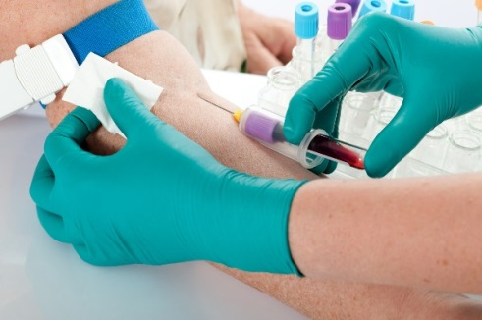
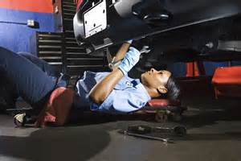
Career Exploration
Notes:
Through this program, you will be able to identify the careers you would enjoy, the amount of money you need to earn to pay for your lifestyle and if there are job openings in that field.

Slide 4
Skill Building
Notes:
You can further develop your skills, work history and references by going on-the-job for a paid work experience. If a certificate or post-secondary program is needed to reach your career goal, the Workforce Training Youth Program may be able to assist in paying for tuition.

Slide 5
Job Search
Who would you hire?
Notes:
Learn the importance of 1st impressions
Have a mock interview so you know the answers to common interview questions and the top skills employers are looking for.
Sell yourself on your resume, cover letter and applications
The DLR has over 14,000 job openings and strong relationships with employers who are looking to hire people like you.

Slide 6
Integrated Resource Team
Job Seeker
DLR
Mentor
Worksite
Counselor
Financial Support
Notes:
Do all of this with the support of your very own Integrated Resource Team. This Integrated Resource Team is a group of service providers and supports who will work together to help you meet your goals. The Department of Labor and Regulation will assist you in developing an employment plan. If financial supports such as purchasing work attire or transportation or daycare are needed along the way, the DLR or another member of your Integrated Resource Team may be able to assist.

Slide 7
Contact a DLR Local Office www.sdjobs.org
Aberdeen 626-2340
Brookings 688-4351
Huron 353-7155
Madison 256-5300
Mitchell 995-8060
Pierre 773-3372
Rapid City 394-2296
Sioux Falls 367-5300
Spearfish 642-6900
Vermillion 677-6900
Watertown 882-5131
Winner 842-0474
Yankton 668-2900
Notes:
What should you do? Contact the Department of Labor and Regulation office nearest you and talk to a Workforce Training Employment Specialist. You can also visit www.sdjobs.org.

